Slide 1
IROS Mini-Project
Proposed by Danil Chegaev & Maxim Kalinin

Slide 2
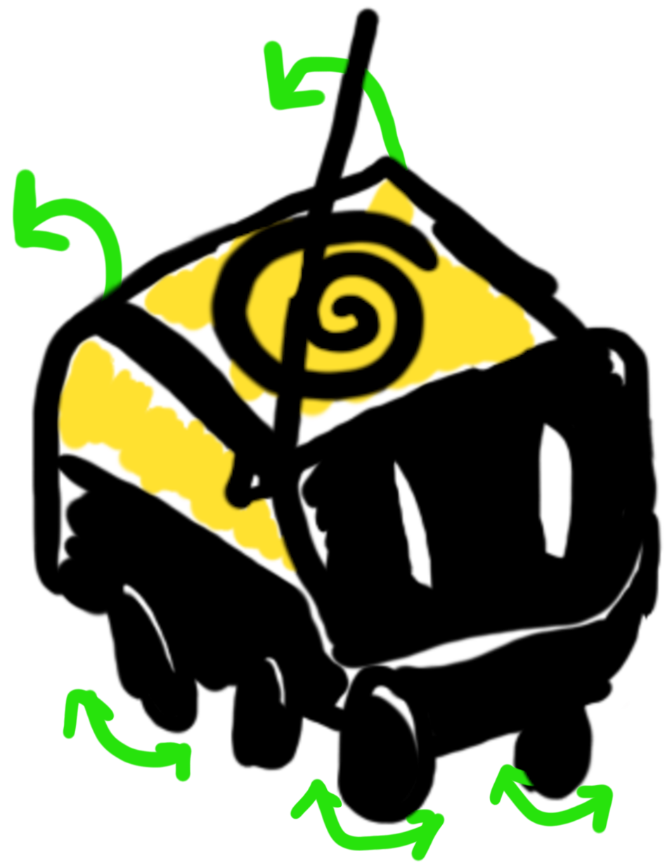
Problems, we are trying to solve:
Building a food delivery robot
Developing an interactive Gazebo environment for it
Control robots through ROS nodes

Slide 3
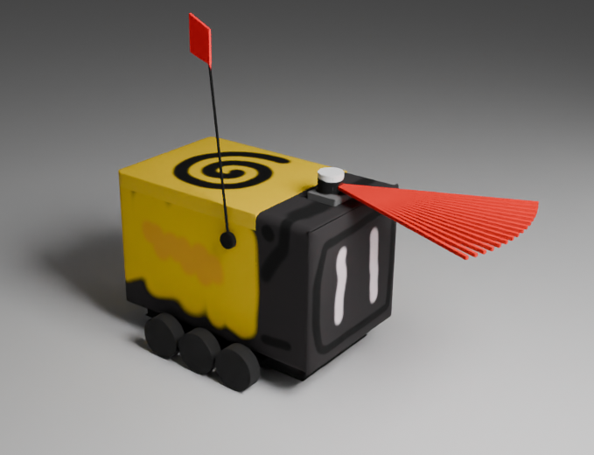
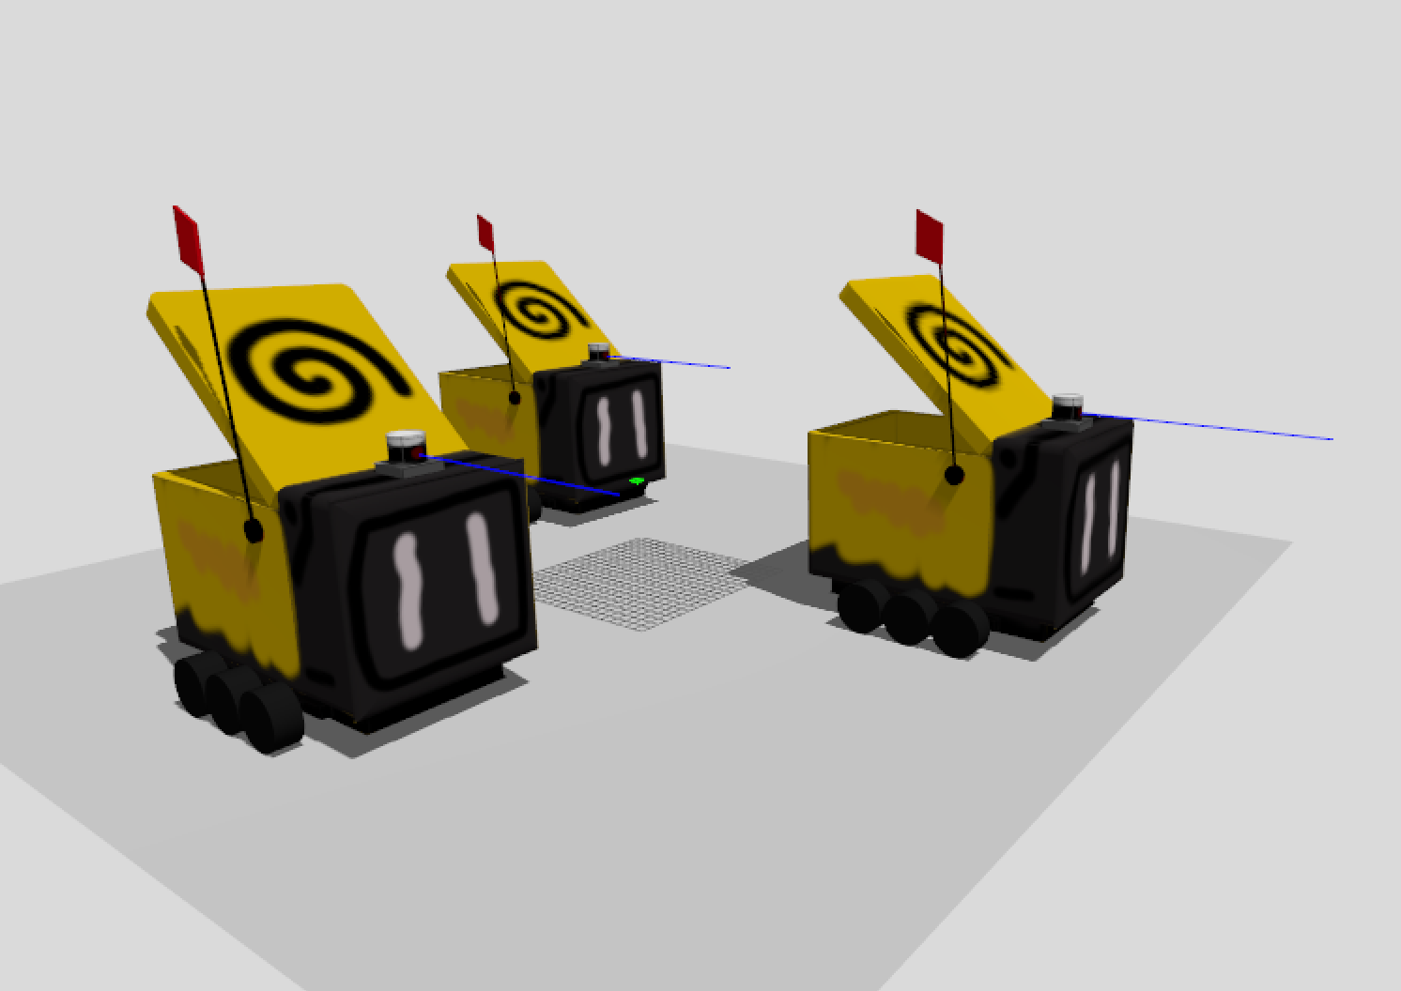
The proposed approach
Multiple delivery robots spawned in Gazebo Sim should be able to move and detect obstacles using LiDAR. The movement should be organized through applying forces and torques for various links of models, which is possible through ros_gz_bridge node

Slide 4
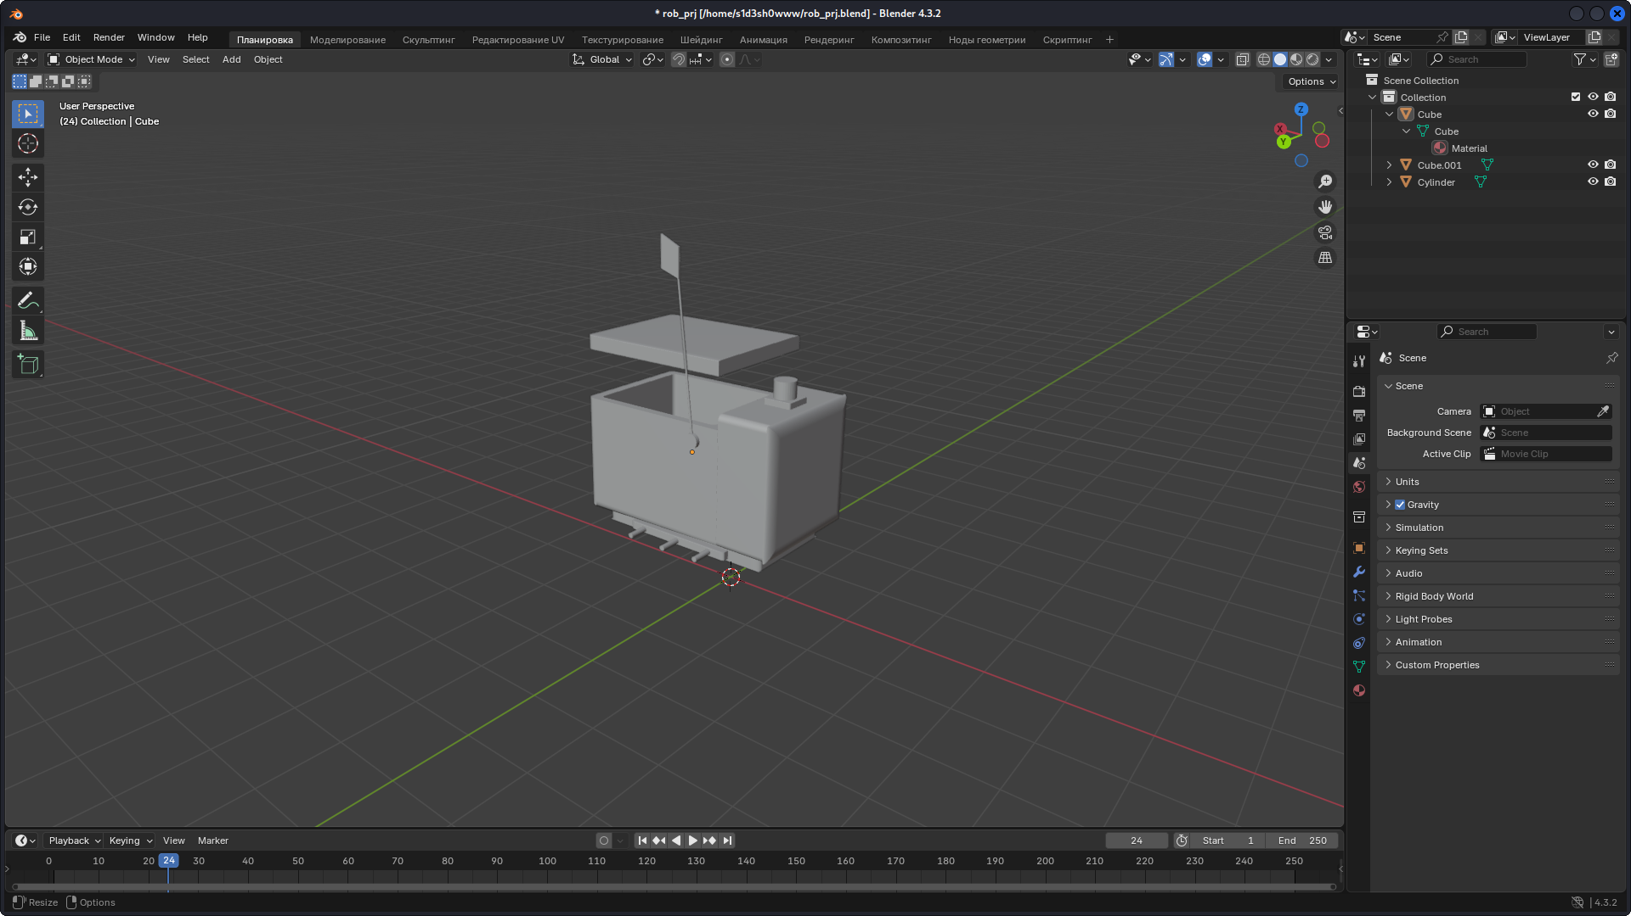

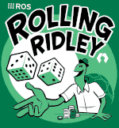
Completed tasks:
Modelling a delivery robot in Blender
Building a link & joint structure of the robot
Migrating to the ROS2 Rolling and Gazebo Sim Ionic
Connecting Gazebo plugins to use LiDAR sensor and Gazebo topics
Writing launch file for automatic nodes execution and Gazebo-ROS bridge establishment
Developing nodes for control the simulation

Slide 5
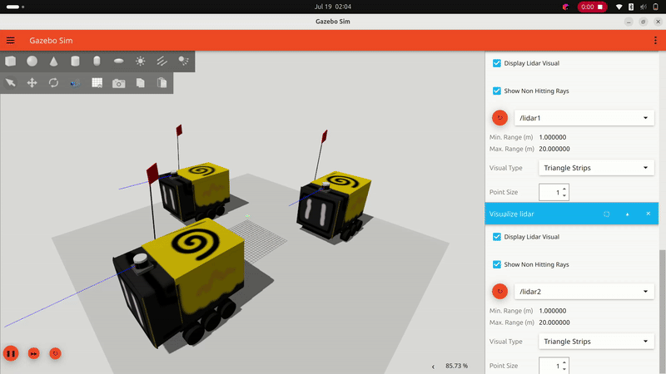
Potential improvements for the robot’s performance:
Currently, robot lid closing and opening process is implemented through simple forces applications, in its final version it should use TF2 for observing current links positions.
Also we will implement other parts of robot functionality, which includes left and right array of wheels and LiDAR data handling

Slide 6
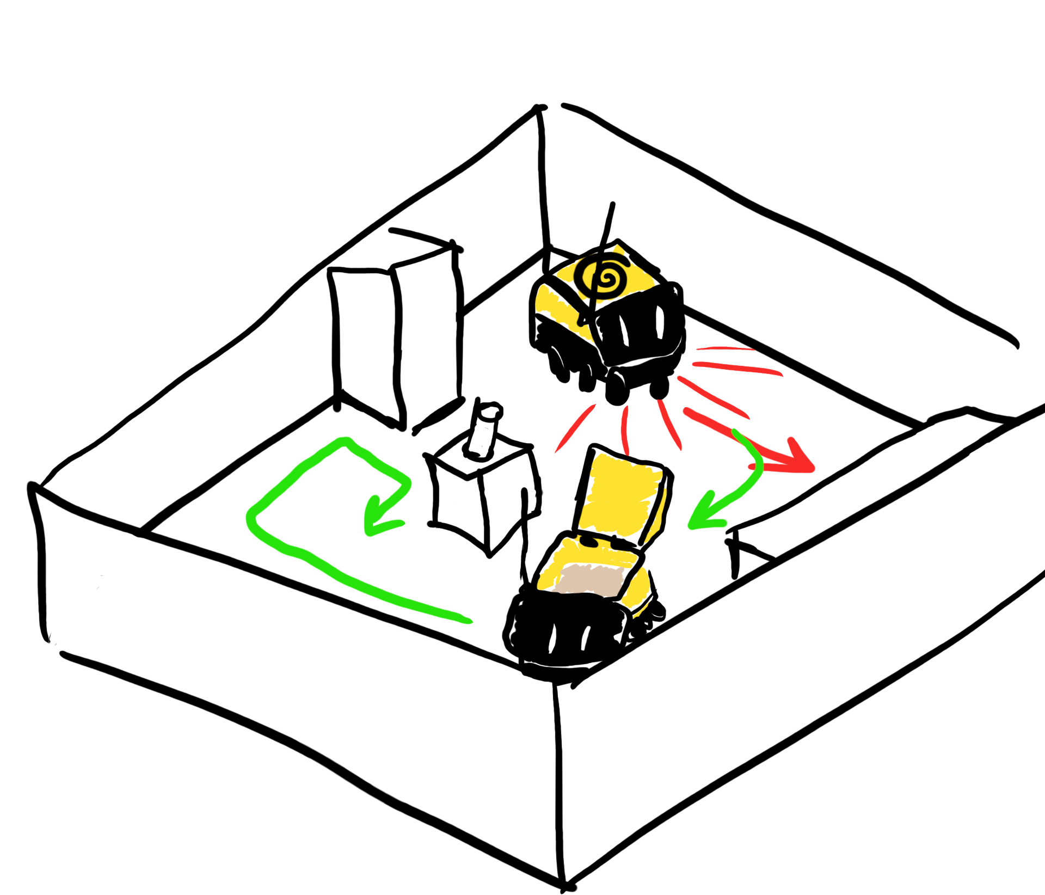
Key takeaways from the project:
We learned how to use simulation description format for developing robots and test them inside Gazebo simulator. We tried to use LiDAR for observing obstacles, TF2 for calculating difference between links positions and ROS-Gazebo bridge to manipulate the simulation from ROS node systems. We plan to finish the project

Slide 7
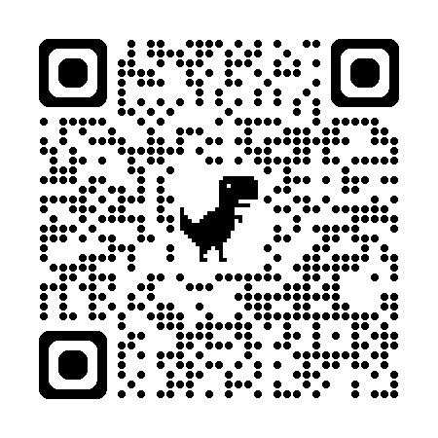
GitHub

